Slide 1


Slide 2
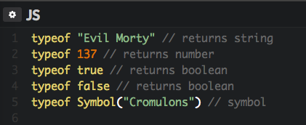
Primitive Data Types
The lowest level used to describe a value is know as a primitive. Primitive data types dictate how an operator treats a value.
String
Number
Boolean
Symbol //ES6

Slide 3
NULL vs undefined
Null
Undefined
Represents the absence of any object value
Represents no value being assigned

